Slide 1


JEWELERY
PRESENTATION
By : Sidhant

Slide 2
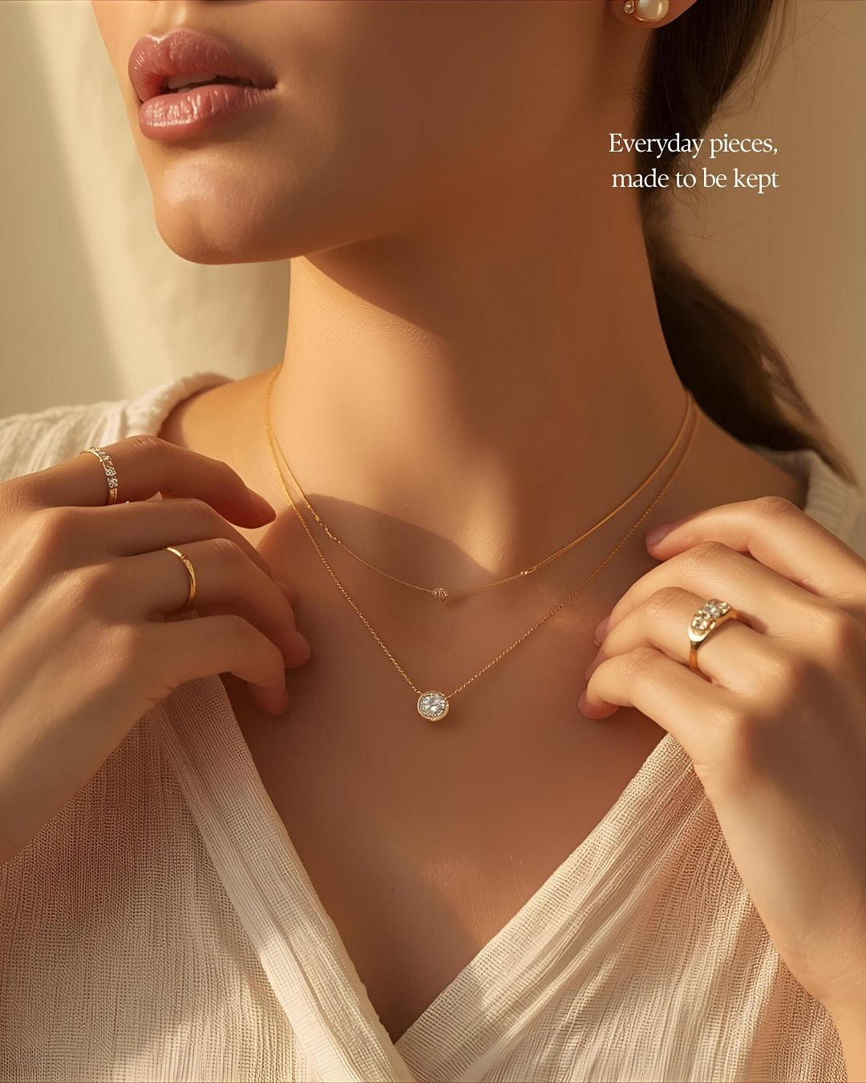


PROJECT OVERVIEW
Peak Jewelicious is a fashion jewellery project focused on offering elegant, anti-tarnish, and affordable jewellery for modern customers. The project aims to create stylish accessories that combine contemporary trends with timeless designs, making them suitable for everyday wear as well as special occasions.

Slide 3

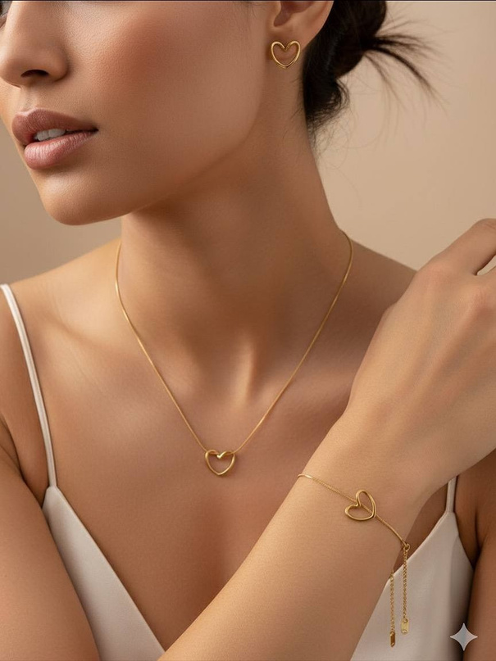
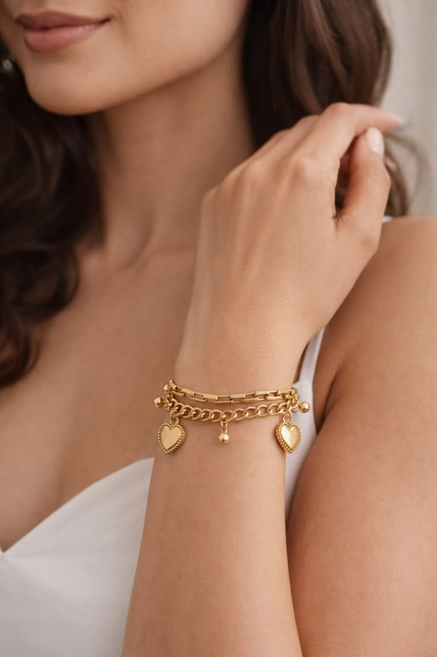
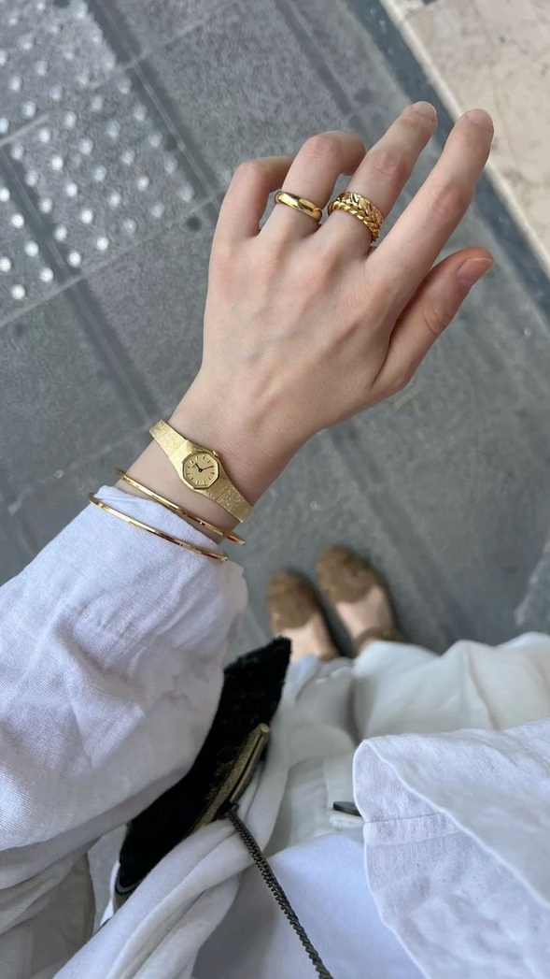
COLLECTION
Bella Heart Set
Love Charm Bracelet
Minimal Muse

Slide 4
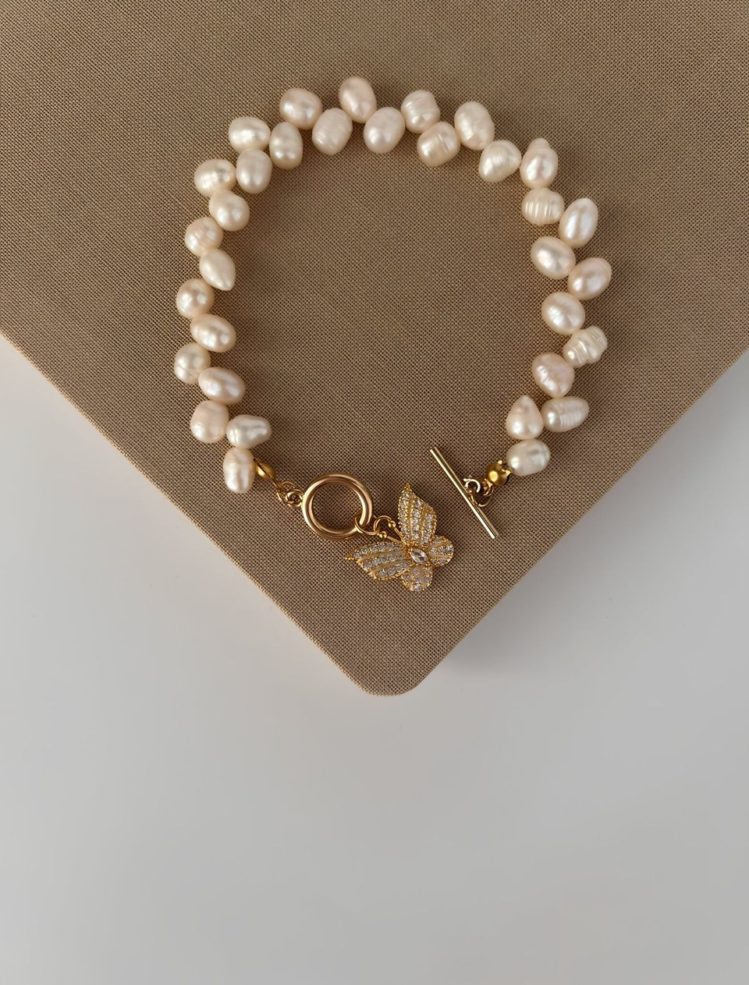
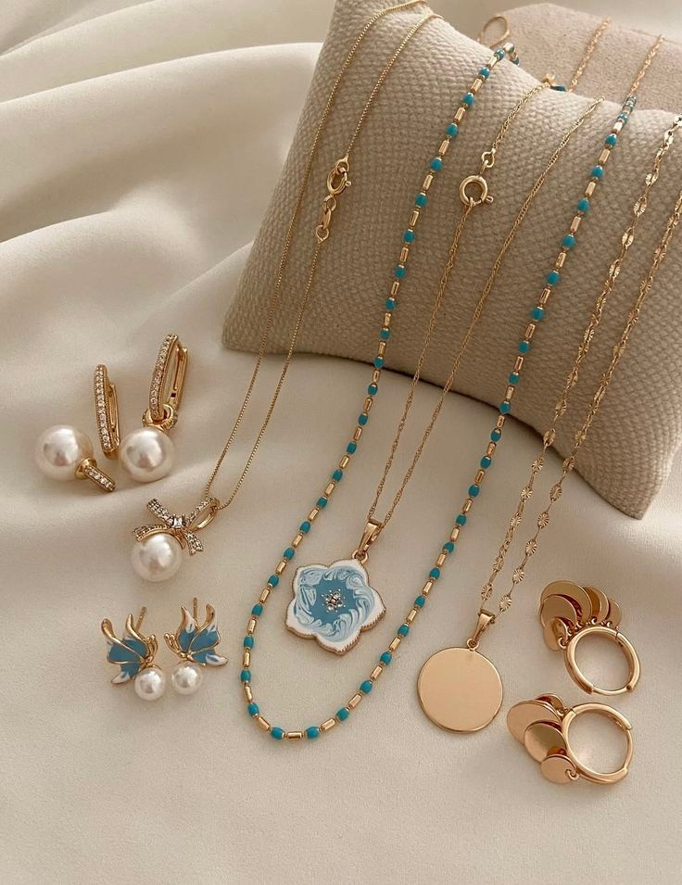
BACKGROUND
Peak Jewelicious is a modern fashion jewellery brand created to bring elegance, quality, and affordability together. Inspired by contemporary trends and timeless beauty, our collections are designed for women who love to express their unique style with confidence.
At Peak Jewelicious, we believe jewellery is more than an accessory—it is a reflection of personality, confidence, and unforgettable moments.

Slide 5

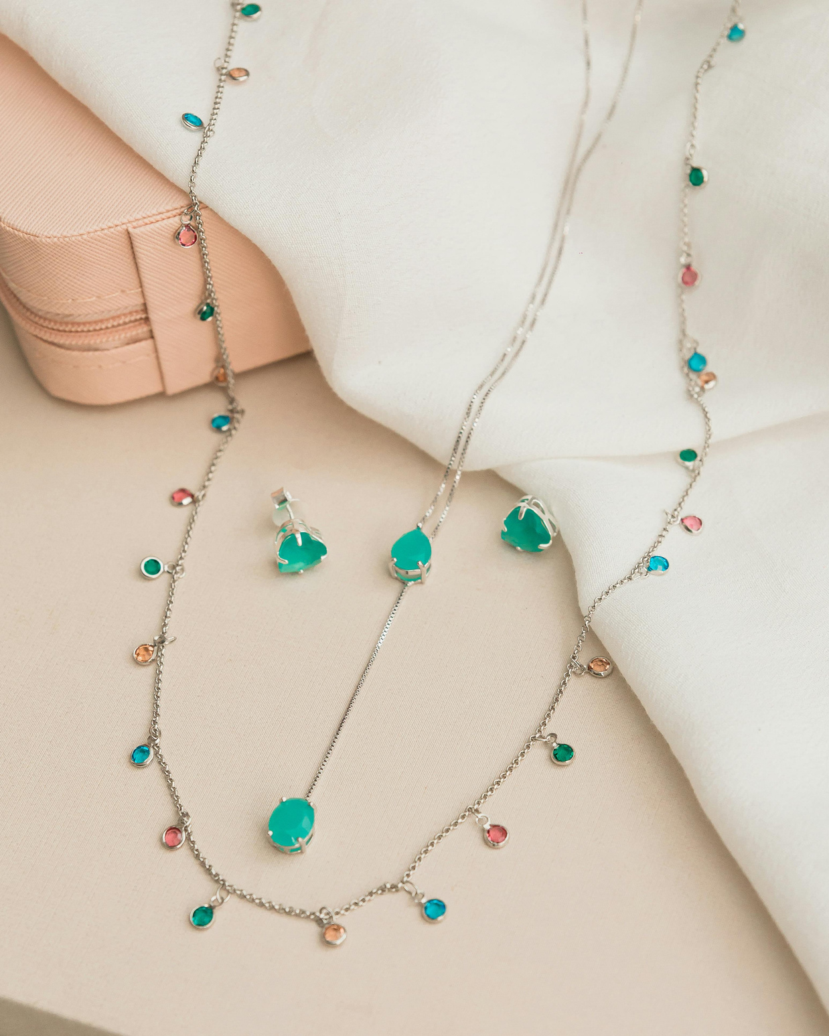

CONCLUSION
Jewellery is the perfect finishing touch that transforms every outfit into a statement of elegance. At Peak Jewelicious, we believe in creating beautiful, durable, and fashionable jewellery that brings joy, confidence, and timeless style to every customer.
Therefore, efforts to improve the quality and must continue to support optimal brand development

Slide 6

THANK YOU
By : Sidhant

